Slide 1

DEPARTMENT OF COMPUTER SCIENCE & ENGINEERING
SCHOOL OF COMPUTING
1156CS701- MAJOR PROJECT
IN-HOUSE
WINTER SEMESTER(2023-2024)
REVIEW - I
SEGMENTING BRAIN TUMOR ON MRI IMAGES USING
LIGHTWEIGHT SE UNET MODEL
SUPERVISED BY
Dr. S. SARAN RAJ
Assistant Professor
PRESENTED BY
1. LOGESHWARAN K S (VTU15366)
(20UECS0530)
2. KALLURI ANISHA DEVI (VTU17604)
(20UECS0441)

Slide 2
AGENDA
ABSTRACT
OBJECTIVE
INTRODUCTION
LITERATURE REVIEW
DESIGN AND METHODOLOGIES
IMPLEMENTATION
CONCLUSION
REFERENCES

Slide 3
ABSTRACT
All over the world, the leading cause of people's death is cancer. Cancer is nothing but a group of abnormal cells that grow beyond the limited boundaries. It infiltrates and destroys normal body tissue and makes it hard for people to survive. Brain tumor has the highest death rate compared to other cancer-affected people. In America (2023), 94,390 people have been diagnosed and their relative survival rate is 35.7%. Brain tumors are diagnosed with the help of Magnetic Reasoning Imaging (MRI) and Computed Tomography (CT) Scan.
With the help of MRI data along with its different modalities, we are proposing a 2-dimensional hybrid architecture with a combination of Squeeze-and-Excitation (SE) to suppress the irrelevant feature to make up the issue of redundancy and U-NET as a base architecture.
Our hybrid architecture provides significant performance while evaluating the MRI T1 dataset. The results obtained through our architecture are accuracy, loss, precision, etc.

Slide 4
OBJECTIVES
Aim of the Project:
To build a Lightweight hybrid model which makes the segmentation of Brain MRI easier with less GPU and memory consumption.
Scope of the Project:
The scope of brain tumor segmentation is to accurately describe the brain tumor site and find its region and surroundings
It can even help the people who are at the earlier stage by detecting the location and extension of the tumor region

Slide 5
INTRODUCTION
Over the past few decades, the field of medical imaging has undergone a revolution with the application of machine learning and deep learning algorithms for the segmentation, identification, and prediction of patient survival from tumors or other diseases. ​
In addition, it helps doctors make an early diagnosis of malignant brain tumors, thus improving the prognosis. Gliomas occur most often in adults and are thought to arise from glial cells and invade adjacent tissues. ​
The primary brain tumor is a glioma. High-Grade Glioblastoma (HGG) and Low-Grade Glioblastoma (LGG) are two other subtypes of glioma. While radiologists manually reviewed Magnetic Resonance Imaging (MRI) modalities to generate quantitative information, segmentation of 2D modalities is cumbersome, with variations and errors.

Slide 6
INTRODUCTION
This challenge is further heightened if tumors vary in size, shape, and location. Tumor-like cells can appear anywhere in brain tissue and can vary in size, appearance, and shape, and it is difficult to automatically segment brain tumors and their subregions. CNNs of different architectures have and use automatic segmentation.
We made a lightweight U-NET architecture by integrating SE block to help physicians improve their performance by performing analyses with the automatic and intelligent systems provided.

Slide 7
LITERATURE REVIEW
H. A. Hafeez et al., "A CNN-Model to Classify Low-Grade and High-Grade Glioma From MRI Images," in IEEE Access, vol. 11, pp. 46283-46296, 2023,
Model : CNN & SVM
The design and development of a CNN-based lightweighted model with 12 layers and 0.287 million parameters
They classify the images with dimensions 256 × 256 image
Accuracy : 81 %

Slide 8
LITERATURE REVIEW
Aledhari, Mohammed & Razzak, Rehma. (2020). An Adaptive Segmentation Technique to Detect Brain Tumors Using 2D Unet. 2328-2334.
Model : 2D UNET (Residual Block)
This paper involves the detailed comparison between 2D-Unets and 2D-RUNets for the purposes of segmenting a whole high-grade glioma (HGG) using the metrics of Jaccard’s similarity, recall, specificity, and precision
Dataset : BraTS
F1 Score – 37%, IOU – 79%, Precision – 41%, Specificity – 100%

Slide 9
LITERATURE REVIEW
Ç. Özkaya and Ş. Sağiroğlu, "Glioma Grade Classification Using CNNs and Segmentation With an Adaptive Approach Using Histogram Features in Brain MRIs," in IEEE Access, vol. 11, pp. 52275-52287, 2023
Model : UNET
The input set is a 4 3D scans (240x240x155) with different contrast settings (T1, T2, T1 with FLAIR and contrast enhancement), and the outcome is a labeled 240x240x155.
Dataset: BraTS
Dice Score: 71%, sensitivity: 91%, specificity: 98%

Slide 10
LITERATURE REVIEW
M. Rizwan, A. Shabbir, A. R. Javed, M. Shabbir, T. Baker and D. Al-Jumeily Obe, "Brain Tumor and Glioma Grade Classification Using Gaussian Convolutional Neural Network," in IEEE Access, vol. 10, pp. 29731-29740, 2022
Model : Gaussian CNN
They apply and analyze various filters for pre-processing (for noise filtering and smoothing the input images) images to improve the classification
Dataset: BraTS, TCIA
The presented work has accomplished (utilizing two datasets) the most noteworthy accuracy rate of 97.14% and 99.8% through this research.

Slide 11
LITERATURE REVIEW
K. Neamah et al., "Brain Tumor Classification and Detection Based DL Models: A Systematic Review," in IEEE Access, vol. 12, pp. 2517-2542, 2024
Model : 3D UNET
They experimented with a multitude of networks and their different combinations before deciding on the 3D U-Net and CNN.
Dataset: BraTS
A rigorous evaluation on the BraTS validation set resulted with the proposed ensemble achieving dice scores of 0.750, 0.906 and 0.846 for enhancing tumor, whole tumor, and tumor core, respectively

Slide 12
DESIGN AND METHOLOGIES
MODULE 1: Collection of Data & Storing
MODULE 2: Preprocessing & Augmenting
MODULE 3: Model Building & Training
MODULE 4: Evaluation & Segmentation

Slide 13
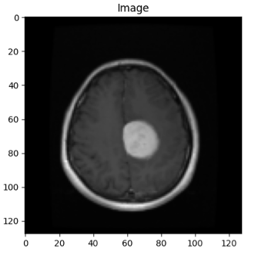
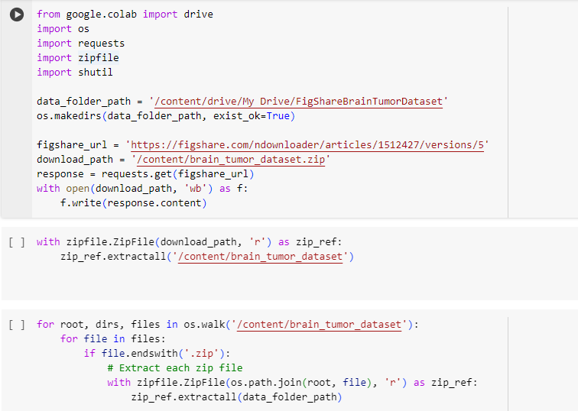
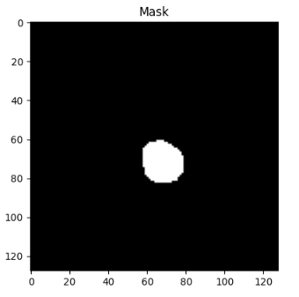
MODULE 1: Collection of Data & Storing
STEP1: DOWNLOADING DATA

Slide 14
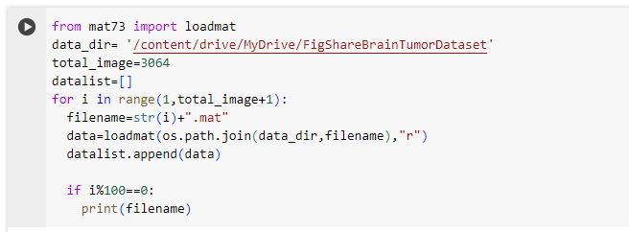
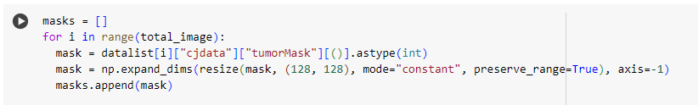
MODULE 1: Collection of Data & Storing
STEP2: EXTRCTING REQUIRED FIELDS ​

Slide 15

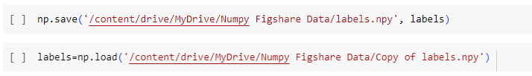
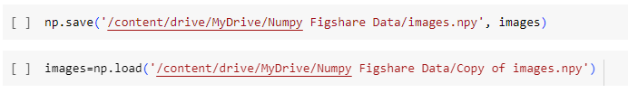
MODULE 1: Collection of Data & Storing
STEP3: SAVING AND LOADING NUMPY DATA​

Slide 16
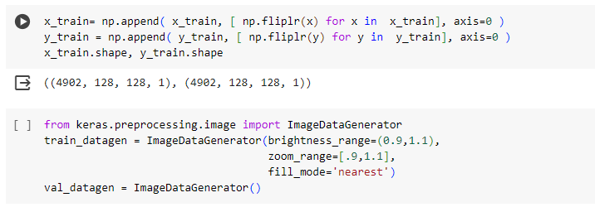
MODULE 2: Preprocessing & Augmenting
STEP1: PREPROCESSING & AUGMENTATION OF DATA ​

Slide 17

MODULE 2: Preprocessing & Augmenting
STEP2: DATA ​SPLIT UP
Train Data: 80%
Test Data: 20%

Slide 18
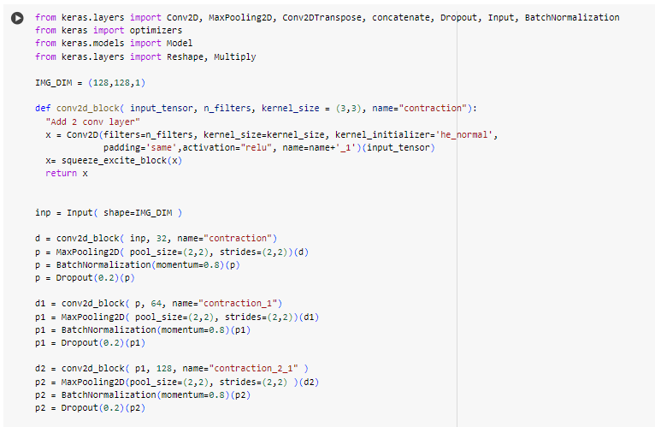
MODULE 3: Model Building & Training
STEP1: MODEL CREATION WITH PARAMETERS

Slide 19

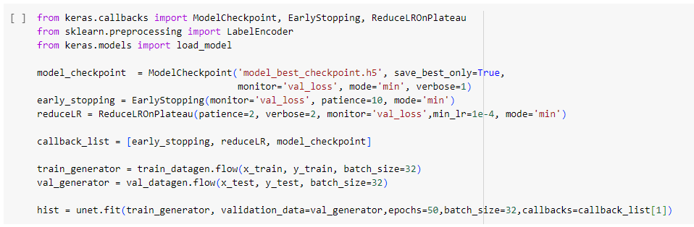
MODULE 3: Model Building & Training
STEP2: COMPLING & TRAINING THE MODEL ​

Slide 20
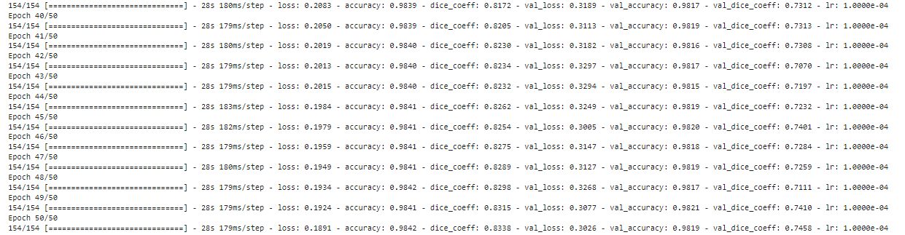
MODULE 4: Evaluation & Segmentation
STEP1: MODEL ​ANALYSIS

Slide 21
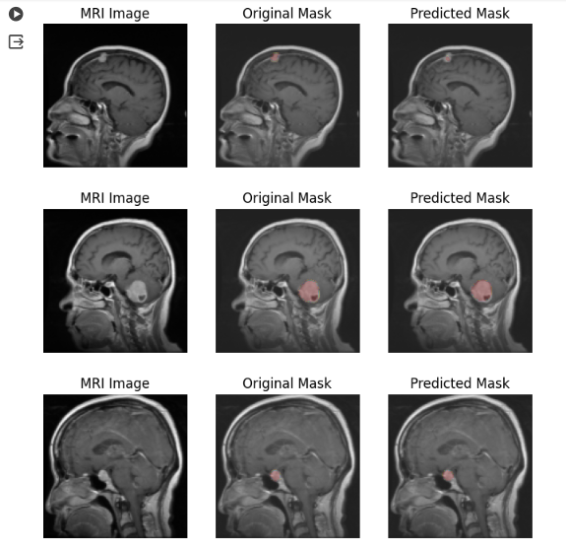
MODULE 4: Evaluation & Segmentation
STEP3: SEGMENTATION

Slide 22
IMPLEMENTATION
Architecture Diagram
Data –Flow Diagram

Slide 23
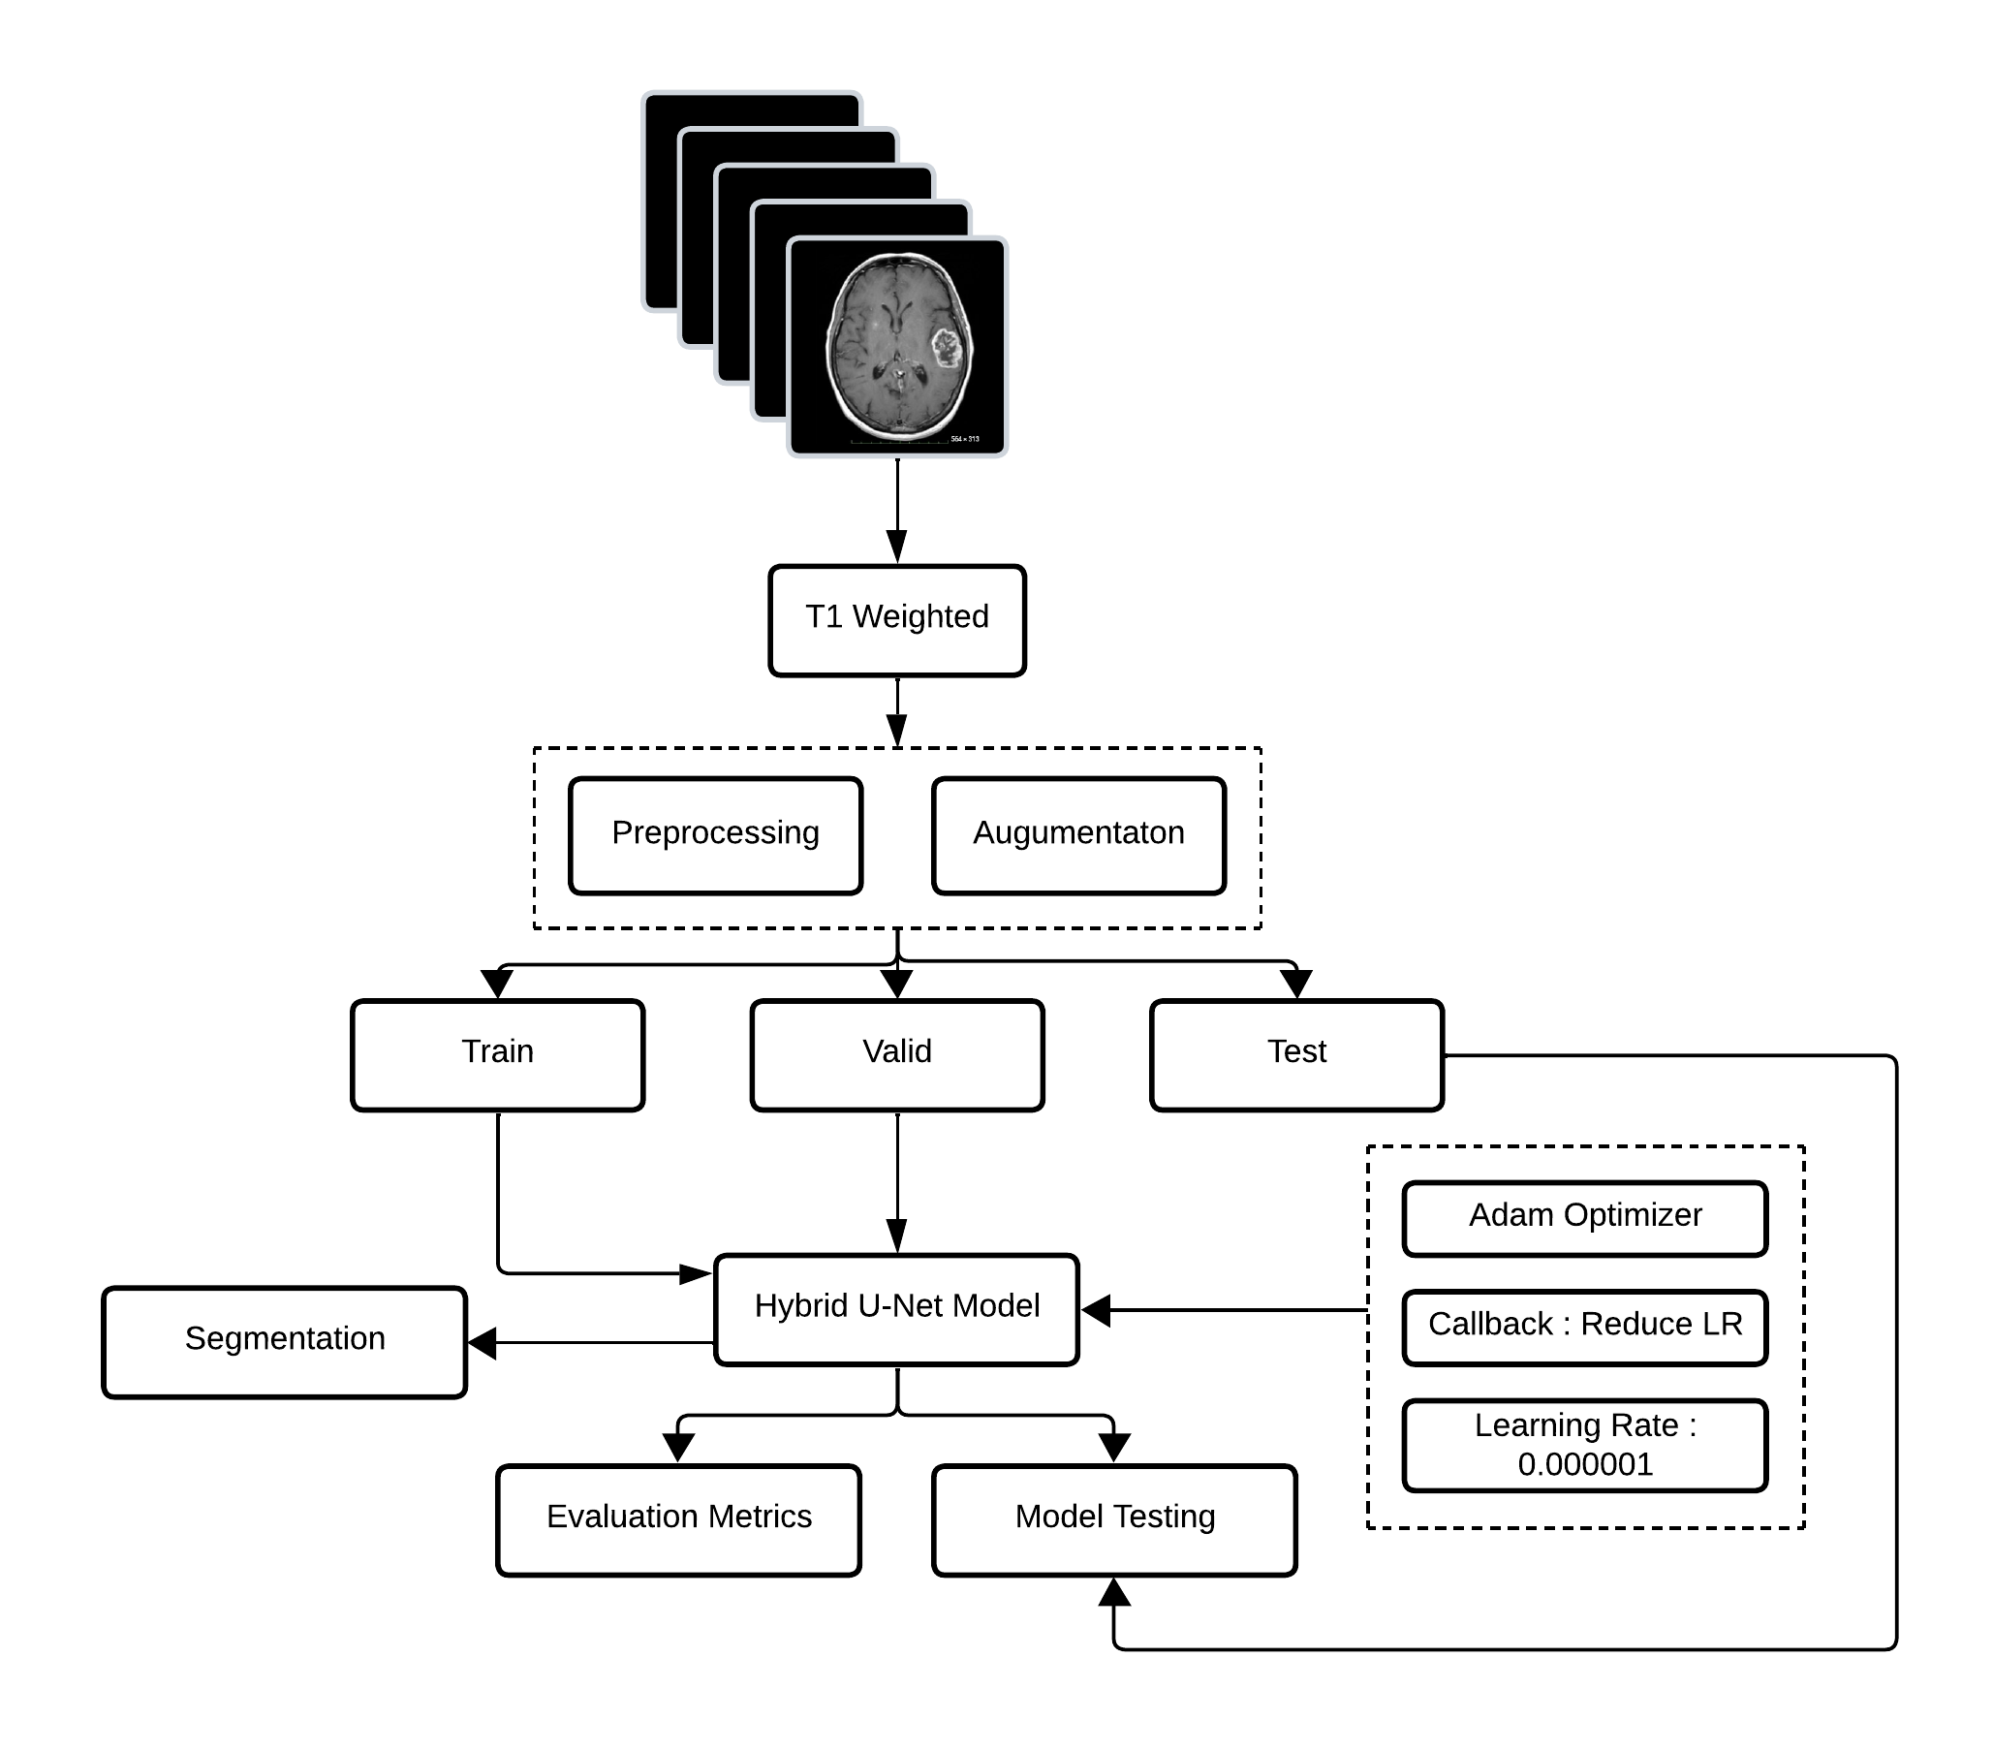
ARCHITECTURE DIAGRAM

Slide 24
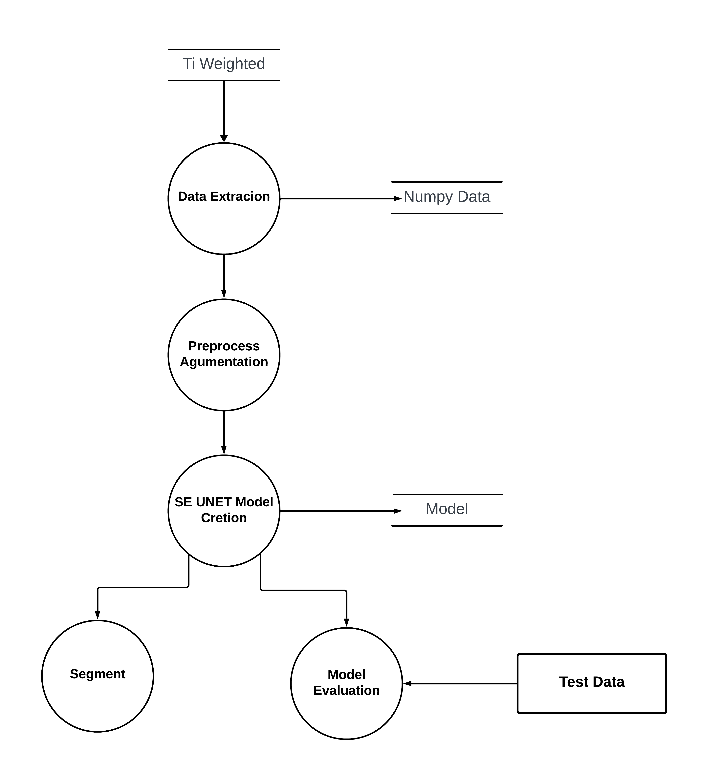
DATA FLOW DIAGRAM

Slide 25
REFERENCES
H. A. Hafeez et al., "A CNN-Model to Classify Low-Grade and High-Grade Glioma From MRI Images," in IEEE Access, vol. 11, pp. 46283-46296, 2023, doi: 10.1109/ACCESS.2023.3273487.
Aledhari, Mohammed & Razzak, Rehma. (2020). An Adaptive Segmentation Technique to Detect Brain Tumors Using 2D Unet. 2328-2334. 10.1109/BIBM49941.2020.9313547.
B. S. Vittikop and S. R. Dhotre, "Automatic Segmentation of MRI Images for Brain Tumor using unet," 2019 1st International Conference on Advances in Information Technology (ICAIT), Chikmagalur, India, 2019, pp. 507-511, doi: 10.1109/ICAIT47043.2019.8987265.
M. Rizwan, A. Shabbir, A. R. Javed, M. Shabbir, T. Baker and D. Al-Jumeily Obe, "Brain Tumor and Glioma Grade Classification Using Gaussian Convolutional Neural Network," in IEEE Access, vol. 10, pp. 29731-29740, 2022
M. Ali, S. O. Gilani, A. Waris, K. Zafar and M. Jamil, "Brain Tumour Image Segmentation Using Deep Networks," in IEEE Access, vol. 8, pp. 153589-153598, 2020, doi: 10.1109/ACCESS.2020.3018160.

Slide 26
REFERENCES
K. Neamah et al., "Brain Tumor Classification and Detection Based DL Models: A Systematic Review," in IEEE Access, vol. 12, pp. 2517-2542, 2024
Ullah, Faizan & Nadeem, Muhammad & Abrar, Muhammad & Amin, Farhan & Salam, Abdu & Alabrah, Amerah. (2023). Evolutionary Model for Brain Cancer-Grading and Classification. IEEE Access. PP. 1-1. 10.1109/ACCESS.2023.3330919.
Ç. Özkaya and Ş. Sağiroğlu, "Glioma Grade Classification Using CNNs and Segmentation With an Adaptive Approach Using Histogram Features in Brain MRIs," in IEEE Access, vol. 11, pp. 52275-52287, 2023
Renugadevi, M. & Kumaravelu, Narasimhan & Ravikumar, CV & Anbazhagan, Rajesh & Pau, Giovanni & Ramkumar, Kannan & Abbas, Mohamed & Raju, N. & Satish, K. & Sevugan, Prabu. (2023). Machine Learning Empowered Brain Tumor Segmentation and Grading Model for Lifetime Prediction. IEEE Access. PP. 1-1.
N. Feng, X. Geng and L. Qin, "Study on MRI Medical Image Segmentation Technology Based on CNN-CRF Model," in IEEE Access, vol. 8, pp. 60505-60514, 2020, doi: 10.1109/ACCESS.2020.2982197.

Slide 27
THANK YOU

